Slide 1
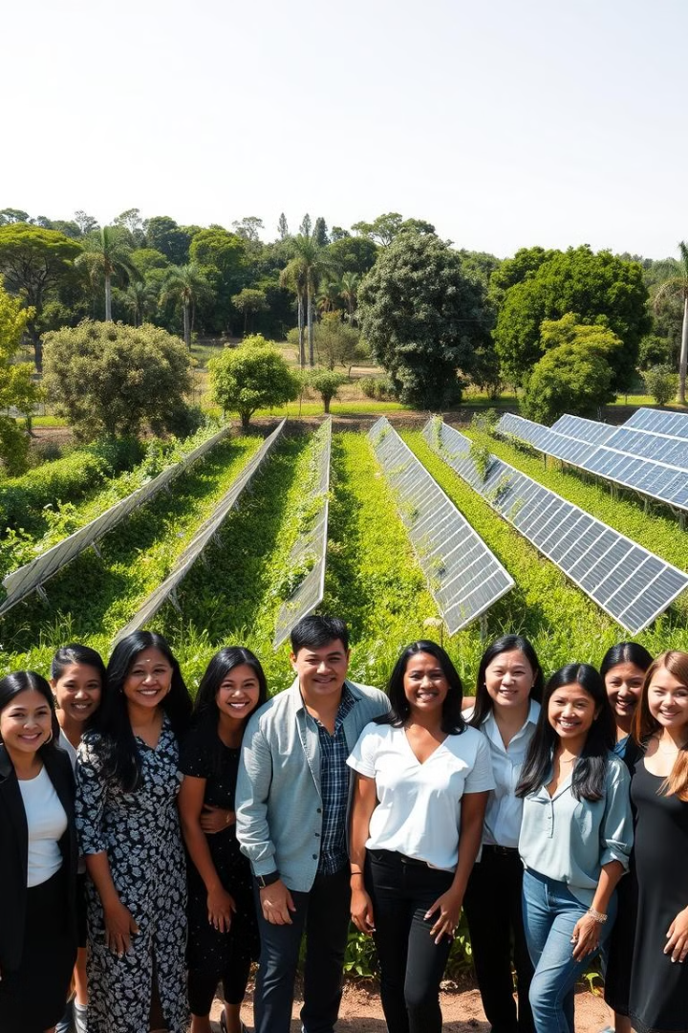
TOPIC: Mental health and well-being surveillance, assessment and tracking solution among children.
The project aims to track and improve children's mental health by checking their well-being and providing early support.
By:
1.Riddhi Shukla - 2200290120133
2.Rishav Ranjan - 2200290120134
3.Riya Sharma - 2200290120136
4.Saurabh kumar Kashinwar - 2200290120153

Slide 2
Project Abstract
Overview:-
Key Objectives:-
Approach:-
The project aims to create a solution that helps identify mental health issues in children early on. By collecting and analyzing data, we can understand trends and provide support where it's needed most..
Monitor Mental Health: Regularly track the mental health status of children to see how it changes over time.
Assess Needs: Use simple tools to evaluate children's mental health and identify any issues.
Early Support: Provide resources and help to children and families as soon as problems are noticed.
Community Involvement: Engage families, schools, and communities to raise awareness and support children's mental health.
Our approach involves collecting data through surveys and assessments from children, parents, and teachers. We will analyze this information to identify mental health trends and collaborate with local communities to raise awareness and provide timely support for children's well-being.

Slide 3

Project Goals and Objectives
Enhance Awareness
1
2
Early Identification
Promote Well-Being
3

Slide 4
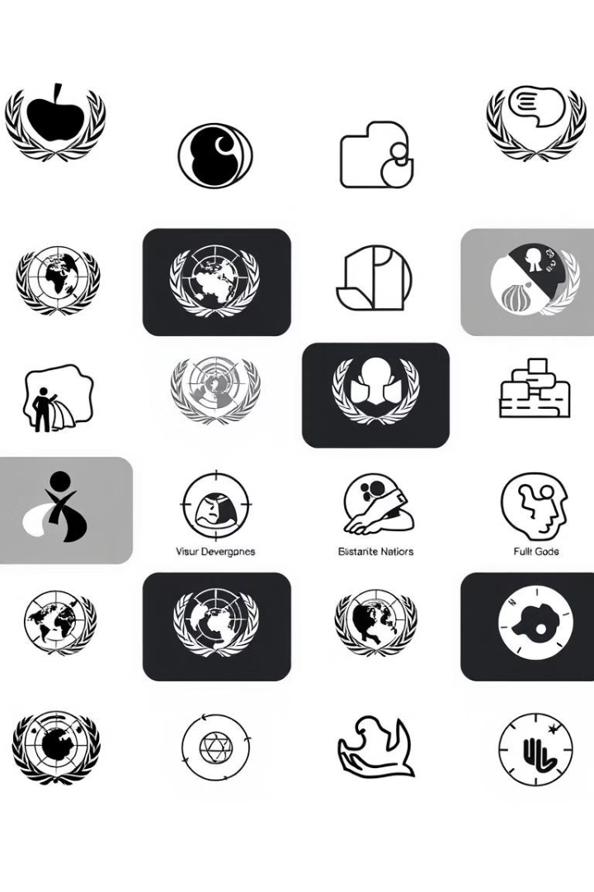
Alignment with UN Sustainable Development Goals (SDGs)
SDG 3: Good Health and Well-Being
SDG 4: Quality Education
Enhances the learning environment by supporting children's mental health.
Focuses on improving mental health and well-being for children.
SDG 10: Reduced Inequalities
SDG 8: Decent Work and Economic Growth
Ensures equitable access to mental health resources for all children.
Promote inclusive economic growth, decent work, and productive employment.

Slide 5





Methodology and Approach
Needs Assessment and Data Analysis
Gather insights from surveys and focus groups to identify children's mental health needs and analyze trends.
Resource Development and Community Engagement
Create educational materials and organize workshops to raise awareness and reduce stigma in the community.
Training and Support Services
Provide training for educators and partner with mental health organizations for counseling and support services.
Monitoring, Evaluation, and Sustainability
Implement evaluation frameworks and develop strategies to ensure long-term support for children's mental health resources.

Slide 6

Expected Outcomes and Impact
1.Increased Awareness:
2.Enhanced Skills and Knowledge:
3.Better Mental Health Outcomes:
Enhanced understanding of children's mental health issues among parents, educators, and community members, leading to reduced stigma
Educators and community leaders equipped with training to recognize and address mental health challenges effectively.
Increased access to counseling and support services, resulting in improved mental health and well-being for children in the community.

Slide 7

Key Project Deliverables
Data Collection Framework
Standardize methods for gathering comprehensive mental health data.
Assessment Tools
Develop validated, age-appropriate tools for identifying mental health issues.
Community Engagement
Involve parents to raise awareness about children's mental health.

Slide 8

Next Steps and Conclusion
1
Stakeholder Engagement
2
Training Implementation
Organize meetings with key stakeholders to discuss project objectives and gather valuable input and insights.
Develop training sessions for educators and healthcare professionals on using tools and recognizing mental health issues.
3
Finalize Assessment Tools
Review and finalize mental health assessment tools, ensuring they are age-appropriate and culturally sensitive.

